Slide 1
Energy Generation in Australia
MONASH BOOTCAMP
Project 2 – Group 6
Group members: Therese Reed, Chao Wang, and Natalie Manahan.

Slide 2
Rationale..
A secure supply of adequate, clean, reliable energy at an affordable price is vital for Australia’s economic growth and prosperity. Fortunately, Australia is well endowed with an abundance of both fossil and renewable fuels. Our energy resources power our homes, cars and industry, and are a key contributor to Australia’s economic prosperity.
To date Australia’s energy needs have been largely met by fossil fuels, but the growth of Australia’s renewable energy industry is increasing.
An understanding where our energy from is important to address our

Slide 3
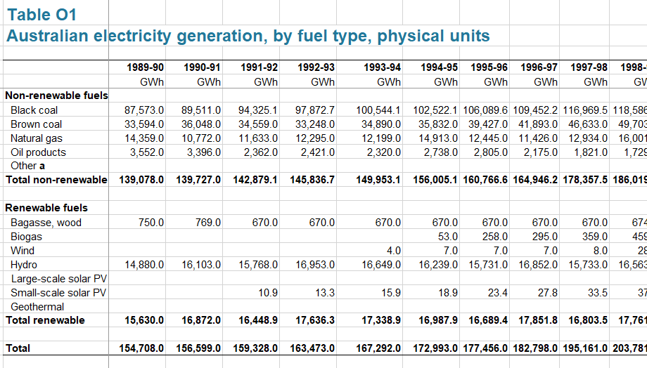
Data Source…
We sourced our data from: https://www.energy.gov.au/
Department of Industry, Science, Energy and Resources.
The data covers all electricity generation in Australia, including by power plants and by businesses and households for their own use.
Data ranges from 1989-90 to 2019-20.

Slide 4
Project Plan..
An interactive dashboard!
All of Australia..
Three dropdown lists:
Energy category; renewable, or non-renewable, or both.
Fuel type; brown coal, black coal, solar or wind etc.
Year (financial), from 1989-90 up to 2019-20.
Visualisations
Bar chart; showing total energy generation (GWH) across the years.
Doughnut chart; showing energy generation (GWH) by fuel type.
States and Territory
Clickable map
Visualisations
A table; summary of state and territory data by fuel type
A line chart showing the energy generation by fuel type

Slide 5
Inspiration..
Australian Fisheries Research and Development Cooperation (FRDC) - Seafood trade dashboard.

Slide 6
Inspiration..
Renewable Energy Dashboard.

Slide 7
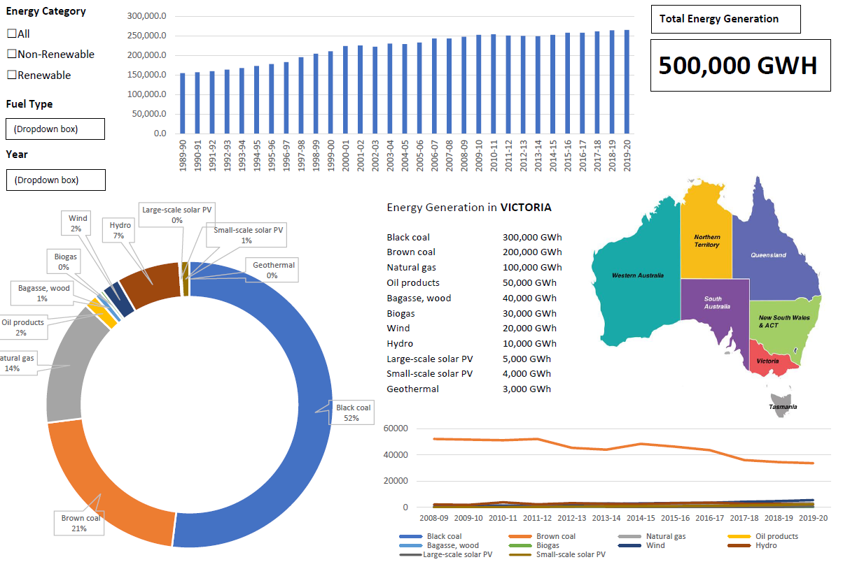
Dashboard sketch..
No doubt ambitious!

Slide 8
ETL Process…
Excel - Cleaning the data
PostgreSQL/PgAdmin – to store the database
Python Flask-powered API – to load the database from PostgreSQL
Visualisations:
HTML – Dashboard structure
CSS – Webpage styling
Javascript – to interact
EXTRA JS library – Chart.js - for the doughnut and the bar chart
Jquery - for map
GeoJson – for map

